Slide 1

Tuesday July 17, 2018
Let’s begin….

Slide 2


Slide 3
Today’s Agenda
Welcome Back and Questions from Kick off
Course Logistics
Review Course Outline and Assignments
Activity Time
For Tonight…
Team Time

Slide 4
Brain Teaser
I have no voice, yet I speak to you. I tell of all things in the world that people do.I have leaves, but I am not a tree.I have pages, but I am not a bride.I have a spine, but I am not a man.I have hinges, but I am not a door.I have told you all. I cannot tell you more.
What am I?
https://icebreakerideas.com/brain-teasers/#Longer_Brain_Teasers_for_Adults

Slide 5

Answer:

Slide 6
Andragogy and Pedagogy
Adult Education Principles

Slide 7
Group Activity
Step #1: In team of no more than 4 people, share each team members concept of andragogy and pedagogy
Step #2: Based on your sharing, develop a team definition to share with the class.

Slide 8
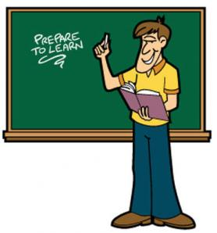
Adult Education Principles
Identify your view of the most significant principle(s) from the readings.
Support your choice(s).

Slide 9
How do these concepts relate to:
Your role an adult educator?
How you design your courses?
How you will deliver your content?
How you will engage your students?
Your perceptions of how adults learn?

Slide 10

For Tonight:
Read your Team Chapter

Slide 11
Reflection Time:
Today we have identified characteristics the adult learners that we will teach.
Reflect on how you represent the adult learner and what principles you most identified with from the readings and discussion today.
Will these be assets to your IDP journey or barriers?

Slide 12


